Slide 1
Structure prediction of protein segments with low target/template sequence identity based on a reduced protein model
Andrzej Szymoszek and Martin Zacharias, AG Theoretische Biophysik,
Institut für Molekulare Biotechnologie, Beutenbergstrasse 11, D-07745 Jena, Germany
Date : July. 29, 2005

Slide 2
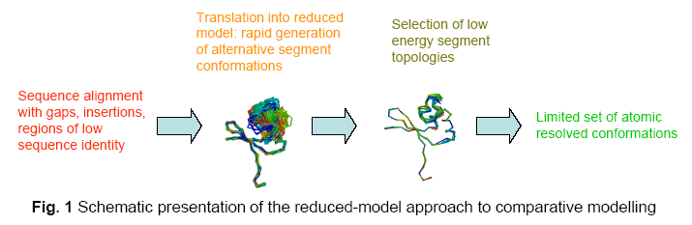

Slide 3
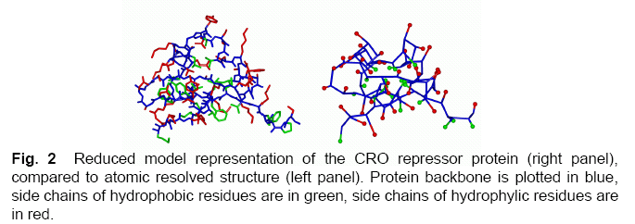

Slide 4
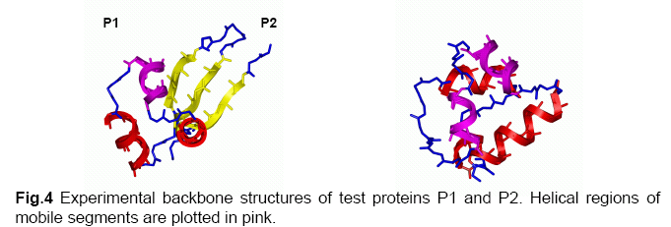

Slide 5
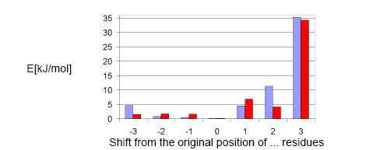

Slide 6
